Slide 1
Key logger & security
CAPSTONE PROJECT
Presented By:
N.Yogesh - P.S.V College of Engineering &Technology – BE(CSE)

Slide 2
Proposed Solution
The proposed system aims to address the challenge of predicting the required bike count at each hour to ensure a stable supply of rental bikes. This involves leveraging data analytics and machine learning techniques to forecast demand patterns accurately. The solution will consist of the following components:
Data Collection:
Gather historical data on bike rentals, including time, date, location, and other relevant factors.
Utilize real-time data sources, such as weather conditions, events, and holidays, to enhance prediction accuracy.
Data Preprocessing:
Clean and preprocess the collected data to handle missing values, outliers, and inconsistencies.
Feature engineering to extract relevant features from the data that might impact bike demand.
Machine Learning Algorithm:
Implement a machine learning algorithm, such as a time-series forecasting model (e.g., ARIMA, SARIMA, or LSTM), to predict bike counts based on historical patterns.
Consider incorporating other factors like weather conditions, day of the week, and special events to improve prediction accuracy.
Deployment:
Develop a user-friendly interface or application that provides real-time predictions for bike counts at different hours.
Deploy the solution on a scalable and reliable platform, considering factors like server infrastructure, response time, and user accessibility.
Evaluation:
Assess the model's performance using appropriate metrics such as Mean Absolute Error (MAE), Root Mean Squared Error (RMSE), or other relevant metrics.
Fine-tune the model based on feedback and continuous monitoring of prediction accuracy.
Result:

Slide 3
System Approach
The "System Approach" section outlines the overall strategy and methodology for developing and implementing the rental bike prediction system. Here's a suggested structure for this section:
System requirements:
-i3 processor
-4gb ram (min requirements)
Library required to build to the model:
Essential basic:
- Pynput
- jsonlib

Slide 4
Algorithm & Deployment
In the Algorithm section, describe the machine learning algorithm chosen for predicting bike counts. Here's an example structure for this section:
Algorithm Selection:
Provide a brief overview of the chosen algorithm (e.g., time-series forecasting model, like ARIMA or LSTM) and justify its selection based on the problem statement and data characteristics.
Data Input:
Specify the input features used by the algorithm, such as historical bike rental data, weather conditions, day of the week, and any other relevant factors.
Training Process:
Explain how the algorithm is trained using historical data. Highlight any specific considerations or techniques employed, such as cross-validation or hyperparameter tuning.
Prediction Process:
Detail how the trained algorithm makes predictions for future bike counts. Discuss any real-time data inputs considered during the prediction phase.

Slide 5

Result

Slide 6


Slide 7


Slide 8
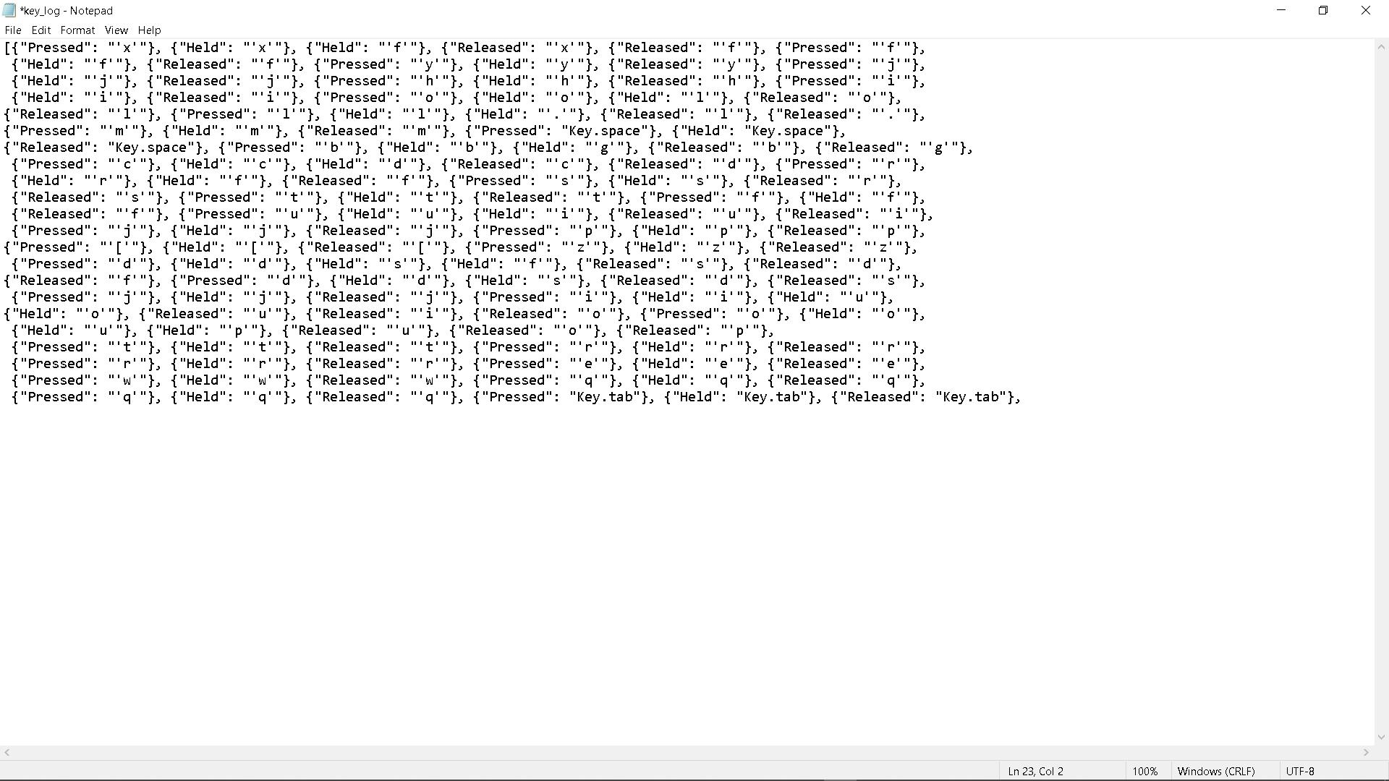

Slide 9
Conclusion
Keyloggers pose a significant security threat by capturing sensitive information without authorization. Implementing strong security measures, such as encryption, access controls, and monitoring, can help protect against keylogger attacks and safeguard data confidentiality. Regular security assessments are essential to detect and address keylogger-related risks effectively.

Slide 10
Future scope
The increasing prevalence of keyloggers underscores the critical need for robust security measures to protect against data breaches and unauthorized access. As technology advances, the future of keylogger detection and prevention will continue to evolve, offering opportunities for innovation in cybersecurity solutions and enhancing overall data protection strategies.

Slide 11
References
Sure! Here are some references that provide information on keyloggers and security: 1. “Keyloggers: How They Work and How to Detect Them” by Digital Guardian – This article provides an overview of keyloggers, how they work, and tips for detecting and preventing them. Available at: https://digitalguardian.com/blog/what-keylogger-how-detect-prevent-keyloggers 2. “The Evolution of Keyloggers: From Hardware to Software” by McAfee – This blog post discusses the evolution of keyloggers from hardware-based devices to software-based applications and the security implications. Available at: https://www.mcafee.com/blogs/consumer/evolution-of-keyloggers/ 3. “Keylogger Detection and Prevention Techniques” by SANS Institute – This whitepaper from the SANS Institute provides detailed information on keylogger detection and prevention techniques, including best practices for securing systems against keyloggers. Available at: https://www.sans.org/reading-room/whitepapers/detection/keylogger-detection-prevention-techniques-33278 4. “Keyloggers: A Threat to Your Security” by Norton – This article from Norton discusses the risks associated with keyloggers and provides tips for protecting your personal information from these malicious tools. Available at: https://us.norton.com/internetsecurity-malware-keyloggers-a-threat-to-your-security.html These references offer valuable insights into keyloggers, their impact on security, and strategies for detecting and preventing them.

Slide 12
THANK YOU

